Slide 1

Graduation Project
Prepared by:
Yazan Farrah
Mutlaq Alsadeed
Supervised by:
Prof. Walid Salameh

Slide 2

The start of a journey…

Slide 3










900,000,000+
Fans

Slide 4
INTRODUCTION
Anime is hand-drawn and computer-generated animation originating from Japan. Outside of Japan and in English, anime refers to Japanese animation, and refers specifically to animation produced in Japan. However, in Japan and in Japanese, anime (a term derived from a shortening of the English word animation) describes all animated works, regardless of style or origin. Animation produced outside of Japan with similar style to Japanese animation is commonly referred to as anime-influenced animation.

Slide 5


Anime Stats and facts
40% - 60% of the globe population watches anime. It’s beginnings was in the 1960s, anime didn’t gain its current popularity until the last couple of decades, and it’s been growing ever since.
In 2020, the global anime industry reached $28.9 billion in revenue. As well as predictions are that anime revenue will reach $61.8 billion by the year 2030.
Demon Slayer is the highest-grossing anime movie of all time which made over $500 million in total since its debut in 2020.

Slide 6
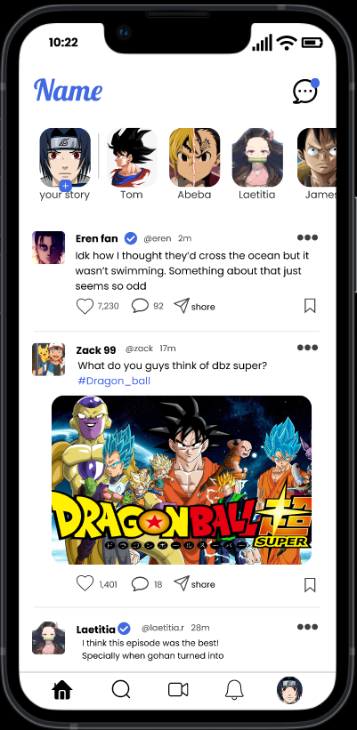
Our Application
Posts(Images, videos, discussions, stories), sending messages to other users, sharing posts with other users, saving posts, reporting posts, comments, likes

Slide 7




New era of scalability and modularity

Slide 8
Perfect Microservice architecture
Mobile
Communicating
api
redis
Database
Request
Response
Cache
MongoDB
web
Communicating

Slide 9



Quality Assurance
The Observer will be using the web application panel to monitor the users content since they’re able to delete posts that violate our terms and block users from a certain activity, give warnings, as well as delete user’s accounts.
CREATORS : Be a warned of toxicity, misbehaviour , as well as racism.

Slide 10
Path of the brave
Marketing Scheme
Senkuo
Word-of-mouth
New Anime
New seasons
Trailers
Content
Small price to pay
First hope
The community
Is it all real?
Mutlaq’s route.

Slide 11



THANK YOU

Slide 12

References:
Cikaric, D., 2022. How Many People Watch Anime?. [online] ReviewMoose.ca. Available at: <https://reviewmoose.ca/blog/how-many-people-watch-anime/#:~:text=While%20it's%20difficult%20to%20pinpoint,it's%20been%20growing%20ever%20since.> [Accessed 23 August 2022].

